Slide 1
Master’s Project Presentation
MSc Computer Animation and Visual Effects
Joshua Bailey

Slide 2

Creative Coding
’Creative Coding’ can be described as a genre of programming with the goal of developing an artefact that is expressive, as opposed to strictly functional (University of the Arts London 2019).
Types of Art:
2D/3D
Virtual Reality/Augmented Reality
Robotics
Musical
Figure 1: Example of Creative Coding (Reddit 2021).

Slide 3
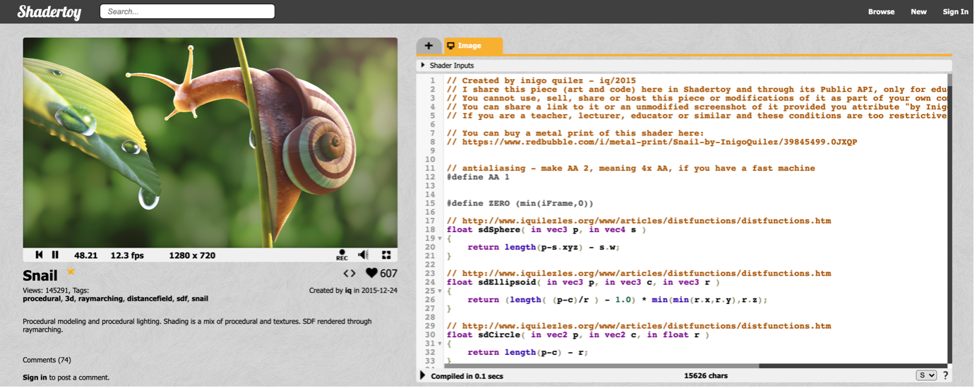
Shadertoy
Figure 2: “Snail” Fragment Shader by Inigo Quilez (Shadertoy 2015).

Slide 4
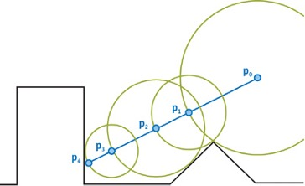
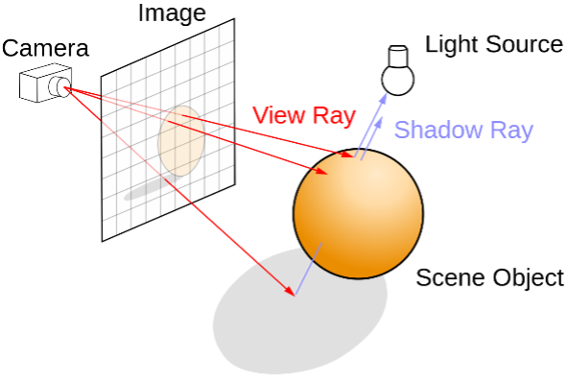
Ray marching
Figure 3: Ray Tracing / Ray Marching scene setup (Wikipedia 2021).
Figure 4: Ray Marching / Sphere Tracing (NVIDIA 2005).
Characterised by Quilez and Jeremias (2014) to provide “a much more powerful way to describe 3D shapes and lighting” (p. 9).

Slide 5
An interactive shader editor made for programmers and artists
Code Editor
An all-access tool designed specifically for users that wish to have direct access to the fragment shader and all its functionality.
Node Editor
Abstracted higher-level tool designed specifically for users with no shader programming experience or for those users who would much prefer to create shader programs using a node-based system.

Slide 6
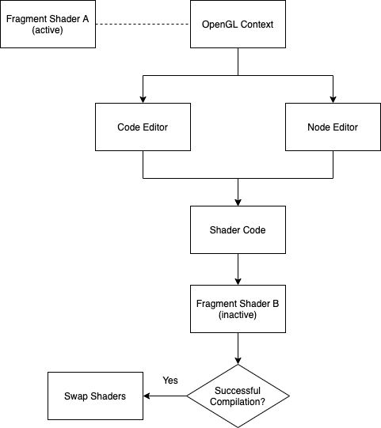
Core functionality
Figure 5: Basic program overview (personal collection).

Slide 7
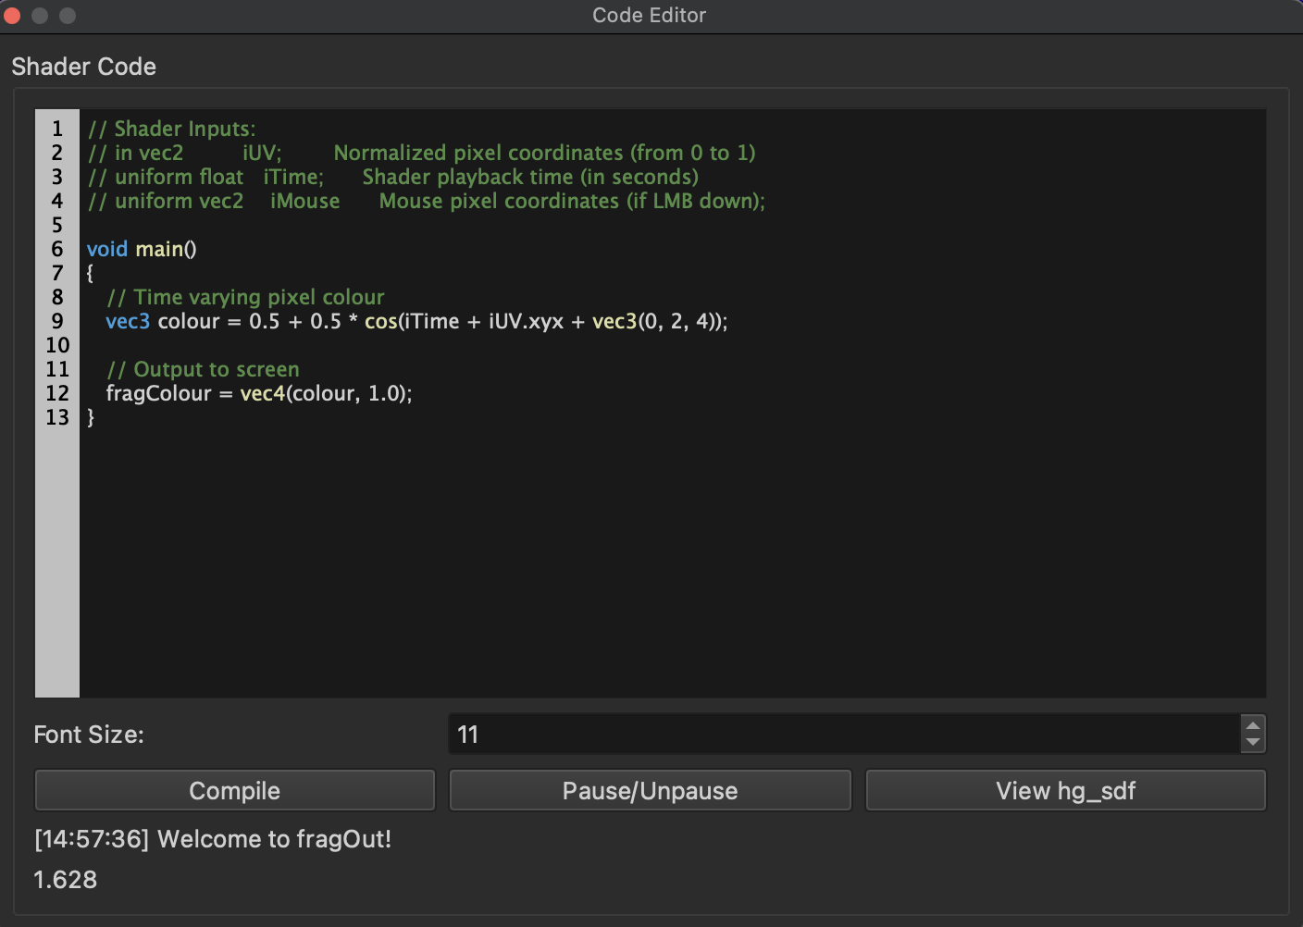
Code editor
Uniforms
Normalized pixel coordinates
Shader playback time
Mouse pixel coordinates
Syntax Highlighting
GLSL v4.10 specification
Other keywords (break, if, for, etc.)
hg_sdf
External library access containing commonly used SDF functions etc.
Figure 6: Code Editor (personal collection).

Slide 8
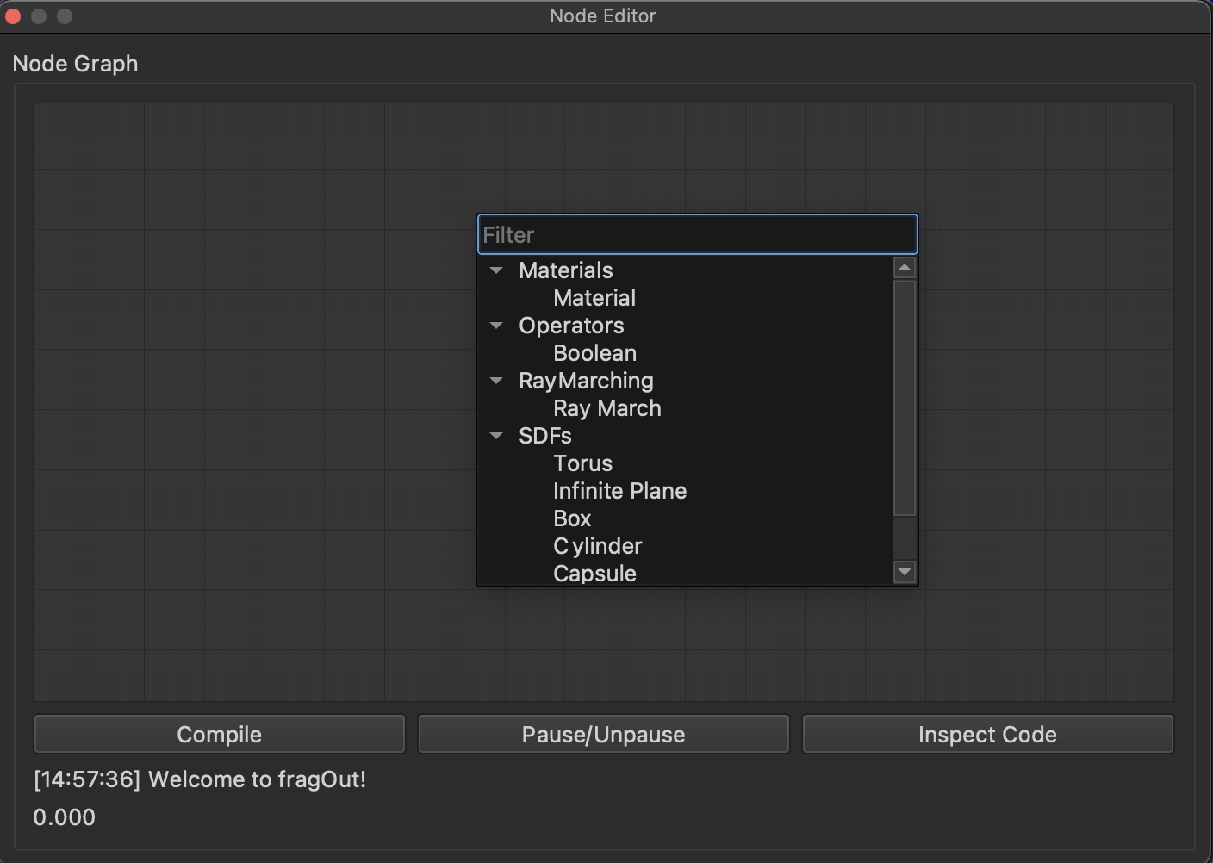
Node editor
Nodes
Signed Distance Functions (SDFs)
Boolean Operators
Materials
Ray March
Code Inspection
Individual node
Compiled code
Node Validation
Errors
Warnings
Figure 7: Node Editor (personal collection).

Slide 9
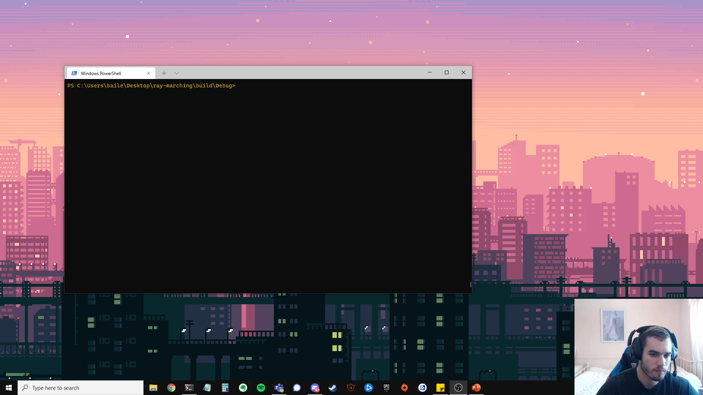
demo

Slide 10
Future work
Additional Nodes:
Space Folding Operators
Smoothing Operators
Group Nodes
Additional Lighting Models
Additional API Support:
DirectX
Vulkan
Metal
Formal Testing:
Programmers and Artists
Identify exactly what ‘is’ needed as opposed to what ‘may’ be needed

Slide 11
Q&A

Slide 12
references
University of the Arts London, 2019. How to Start Creative Coding [online]. Available from: https://www.arts.ac.uk/study-at-ual/short-courses/stories/how-to-start-creative-coding [Accessed 21 August 2021].
Reddit, 2021. “3x33” [online]. Available from: https://www.reddit.com/r/creativecoding/comments/le1z8o/3x33/ [Accessed 22 August 2021].
Shadertoy, 2015. ”Snail” [online]. Available from: https://www.shadertoy.com/view/ld3Gz2 [Accessed 20 July 2021].
Wikipedia, 2021. Ray Tracing (Graphics) [diagram]. Available from: https://en.wikipedia.org/wiki/Ray_tracing_(graphics) [Accessed 24 July 2021].
NVIDIA Corp., 2005. GPU Gems 2 [diagram]. NVIDIA Corp.

